Slide 1
BOOK RECOMMENDATION SYSTEM
Abhijeet Khokhar(211507)

Slide 2
INTRODUCTION
With the increase of library collections, it is difficult for readers to quickly find the books they want when choosing books. Book recommendation system is becoming more and more important.
This system proposes a book recommendation algorithm based on collaborative filtering and popularity based filtering.
It finds the most similar neighbouring books of the user and recommend the books that they may prefer to read.

Slide 3
OBJECTIVES
The purpose of this book recommendation system is to predict buyer's interest and recommend books to them accordingly.
The objective of this system is to provide recommendations based on recorded information on the users' preferences like the number of ratings given to a book. These systems use filtering techniques to process information and provide the user with potentially more relevant items.

Slide 4
RESEARCH PAPER GAPS
After going through all the research papers, some missing information I have noticed are:-
Conceptual Gap:- Population(certain age group, gender), time period(some books take years to complete).
Methodological Gap:- Methods used here are only suggesting similar books, but there should be a method to suggest new and different books for user that they may like.

Slide 5
ABOUT DATASET
This dataset has been taken from Kaggle and used on our model. Attributes of this dataset contains user details, books details and ratings.
By applying this simple dataset and related tasks,I will go through different paradigms of recommender algorithms . For each of them, I will present how they work, describe their theoretical basis and discuss their strengths and Iaknesses.

Slide 6
CONTENT
USERS: It contains the USER-ID, their location and age(if required).
BOOKS: Books are identified by their respective ISBN. Invalid ISBNs have already been removed from the dataset. Moreover, it contains Book-Title, Book-Author, Year-Of-Publication. URLs linking to cover images are also given, appearing in three different categories (Image-URL-S, Image-URL-M, Image-URL-L), i.e., small, medium, large.
RATINGS: Contains the book rating information. Ratings are either expressed on a scale from 1-10 (higher values denoting higher appreciation) or expressed by 0.

Slide 7
ABOUT MODEL
POPULARITY BASED FILTERING
In this technique,I have counted the number of ratings on each book first and then I have calculated the average rating of the book.
After this I will consider only “top 50” books which has minimum 250 ratings given by user.
In this way, I will get those books which are very popular and users may like those books.
COLLABORATIVE BASED FILTERING
In this technique, I will create a new dataframe of books and users which contains how many times user read that book.
The main criteria is I will consider those books which has at least 50 number of ratings and those users who has rated more than 200 books.
For similarity, I will calculate the cosine similarity betIen two books and from that I will get those books which are similar to each other.

Slide 8
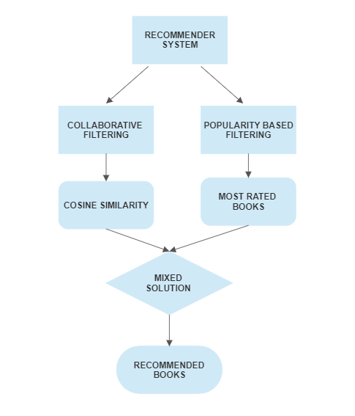
FLOWCHART

Slide 9
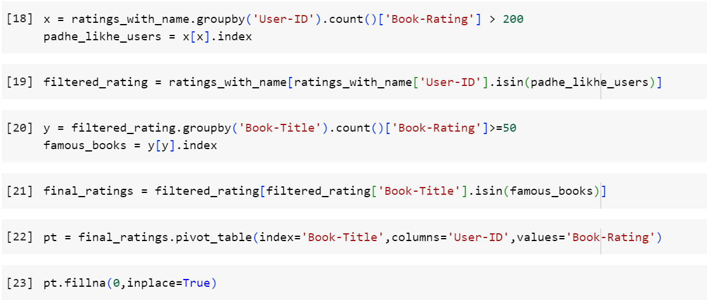
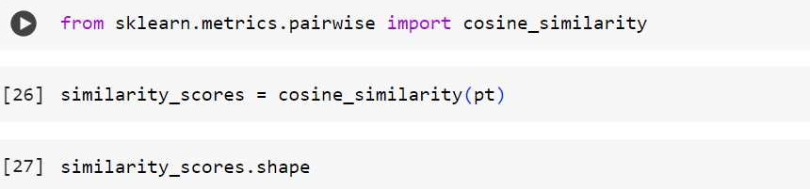
IMPLEMENTATION
Figure: Collaborative based filtering

Slide 10
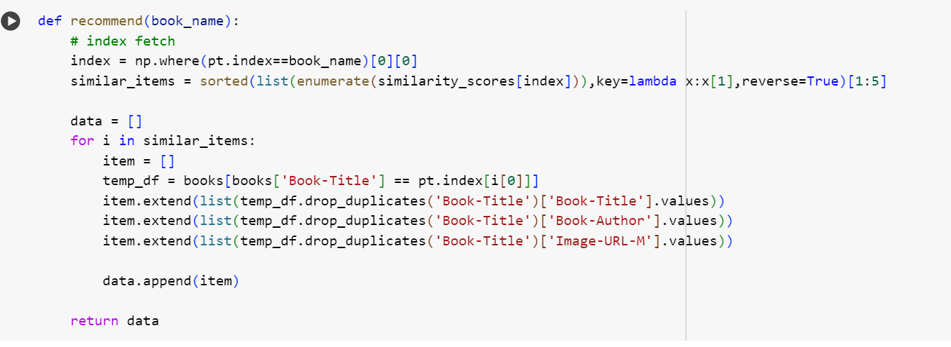
IMPLEMENTATION(cont..)
Figure: Recommender model

Slide 11
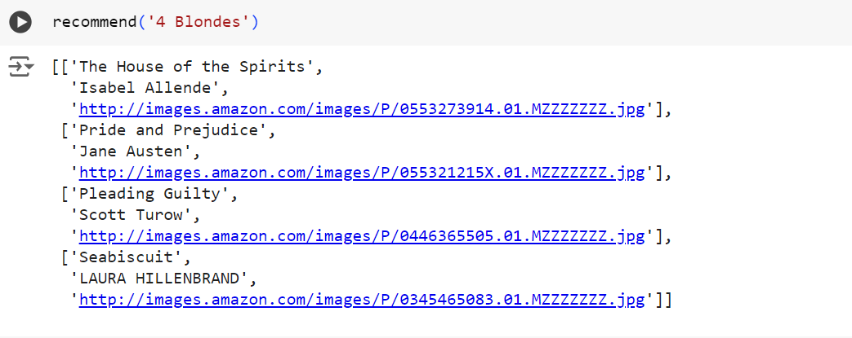
EXPERIMENTAL RESULTS
Figure: Recommended books

Slide 12
FUTURE WORK
I intend to collect additional datasets to increase the variety and size of the data used.
I aim to explore advanced techniques such as mechanisms and supervised learning to further enhance the model’s performance.
I’ll make a user-friendly Ibsite for this recommender system.

Slide 13
THANKS.

